Slide 1

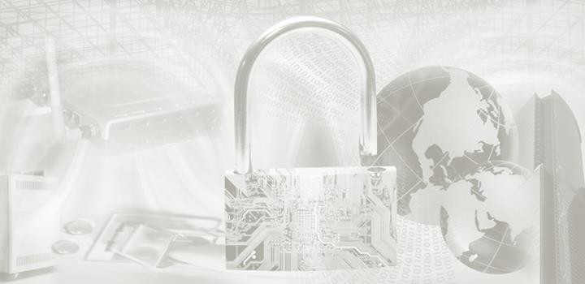
ITEC614 Introduction to Cyber Security
Dr. Farshid Keivanian
Lecturer, Information Technology, PFBS

Slide 2
Impacts of Security Breaches
Lecture 11

Slide 3
Previous Lecture
Have studied…
Laws vs ethics
Ethics vs policies
Law related to computer crime
Ethics in InfoSec
Codes of ethics
Privacy

Slide 4
Outline
Impacts of cyber attacks
Threats on IoT
Threats on Ass
Threats on wearables
Opportunity
Challenges

Slide 5
References
This lecture is based on ACS cybersecurity report and online resources.
https://www.acs.org.au/insightsandpublications/reports-publications/cybersecurity-threats-challenges-opportunities.html

Slide 6
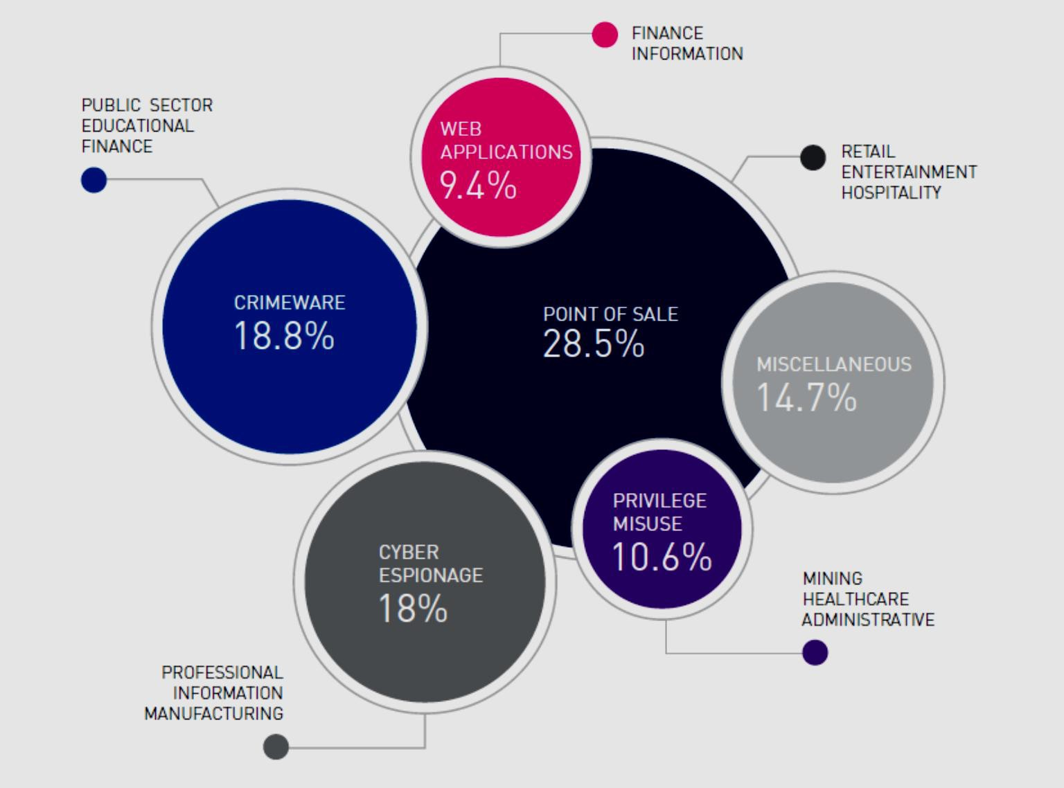
Introduction to Threat Vectors
What is a Threat Vector?
A threat vector is the path or method a hacker uses to gain unauthorized access to your system or data — like how a thief might enter a house through a window, door, or even the chimney.

Slide 7
Point of Sale (28.5%)
Point of Sale (POS) systems are used in shops and restaurants to take payments. Hackers target them to steal credit card data.
Real-World Analogy: It’s like someone installing a hidden camera at a cashier terminal to steal your card info when you pay.

Slide 8
Crimeware (18.8%)
Crimeware refers to software created to commit crimes online, like stealing data or passwords.
Real-World Analogy: Think of it like a pickpocket using special tools in a crowded market to quietly steal wallets.

Slide 9
Cyber Espionage (18%)
This is spying through the internet — usually done by governments or competitors to steal secrets.
Real-World Analogy: Like someone sneaking into a company’s office to take photos of confidential plans.

Slide 10
Miscellaneous (14.7%)
This includes all other ways systems are attacked that don’t fall into the main categories — like human error or physical theft.
Real-World Analogy: Like leaving your house keys at a café and someone uses them to break in.

Slide 11
Privilege Misuse (10.6%)
This happens when insiders (like employees) abuse their access rights to steal or damage information.
Real-World Analogy: Like a trusted cashier using a manager’s key to open the safe and take money.

Slide 12
Web Applications (9.4%)
Hackers exploit bugs in websites to access databases, accounts, or control servers.
Real-World Analogy: Imagine someone finding a hidden door into a building because the builder forgot to lock it

Slide 13
Cyber Espionage (Again - Industry Focused)
Targeted Industries:
Professional Services
Manufacturing
Information Technology
Note: These sectors are targeted for trade secrets and intellectual property.

Slide 14
Summary – Which Threats Are Most Common?
Most common threat: Point of Sale (28.5%)
Rising concerns: Crimeware and Cyber Espionage
Don’t forget: Insider threats and web vulnerabilities are still major risks

Slide 15
Summary – Which Threats Are Most Common?
Discussion Question:
Which threat vector do you think is hardest to prevent and why?

Slide 16
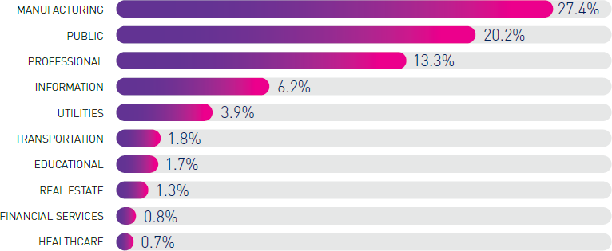
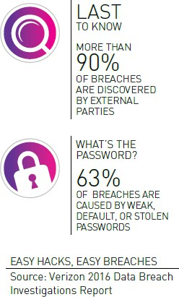
Easy Hacks, Easy Breaches
Top 3 Targeted Industries for Espionage (2015)
Manufacturing – 27.4%
Public Sector – 20.2%
Professional Services – 13.3%

Slide 17
Easy Hacks, Easy Breaches
Real-world analogy: Think of each industry as a different type of house. Manufacturing is like a house with lots of valuables but weak locks—hackers love it because it’s worth it and easy to break in!

Slide 18
Easy Hacks, Easy Breaches
How Do Breaches Happen?
63% caused by weak, default, or stolen passwords → Like using "123456" as your front door key!
90% of breaches are found by outsiders, not the company itself → Like your neighbors telling you your window’s broken before you notice!

Slide 19
Easy Hacks, Easy Breaches
Other targeted industries include: Information, Utilities, Transportation, Education, Real Estate, Finance, Healthcare.

Slide 20
Easy Hacks, Easy Breaches
Key Takeaway: Use strong passwords, enable 2FA, and stay alert. Whether you’re in business, IT, or healthcare, cyber awareness is everyone’s job.

Slide 21
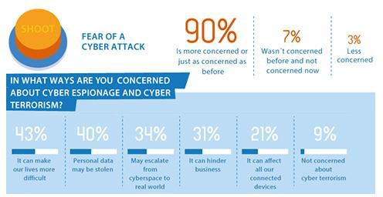
Cybercrime Hits Close to Home
Key Points:
47% of people have faced cybercrime in the past year.
Credit card fraud is the most common (20%), followed by social media hacks (16.5%).

Slide 22
Cybercrime Hits Close to Home
Real-world analogy: Think of your online accounts like your house. Imagine if half of your neighborhood got robbed last year—and many didn’t even change the locks after!
Student Tip: Never reuse passwords. Always lock your digital doors with 2FA and strong passphrases.

Slide 23
Who’s Most at Risk?
Key Points:
41% think banks are the #1 target.
23% worry about big companies being attacked.
9.5% fear retailers, despite lots of stolen credit card data.

Slide 24
Who’s Most at Risk?
Real-world analogy: Cybercriminals go where the money and data are—like thieves choosing between a jewelry store, a shopping mall, or a small bakery.
Student Tip: Whether you're developing apps or handling customer data, security by design matters.

Slide 25
Malware, IoT, and Growing Fear
Key Points:
64% of people avoid or hesitate buying smart home/IoT devices.
55% believe malware is still the biggest danger.

Slide 26
Malware, IoT, and Growing Fear
Real-world analogy: It’s like buying a “smart” fridge that might spy on you or get hacked to leak your private photos.
Student Tip: IoT devices are convenient, but must be updated, monitored, and protected like any other computer.

Slide 27
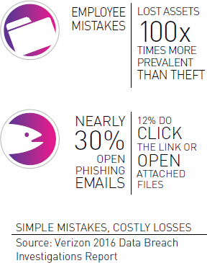
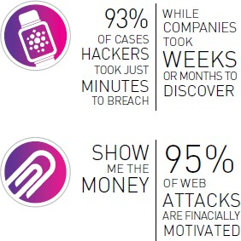
A World Without Cyber Security
Key Messages:
Critical infrastructure (like power grids, transport, and communication systems) is a top target in cyberwarfare.

Slide 28
A World Without Cyber Security
Our increasing use of automation means one tiny failure—like a single hacked device—can shut down an entire system.

Slide 29
A World Without Cyber Security
Real-World Analogy: Imagine your whole house runs on a smart home system. If someone hacks the app, they can turn off your lights, unlock your door, and stop your heater—all at once. Now scale that up to an entire city!

Slide 30
A World Without Cyber Security
Quick Stats to Remember:
93% of hacks take minutes, but detection can take weeks.
95% of attacks are all about money.
Employee mistakes cause losses 100x more than theft.
30% open phishing emails. 12% even click dangerous links.

Slide 31
A World Without Cyber Security
Student Tip: Cybersecurity isn’t just an IT issue—it's a societal safety issue. Whether you're coding, managing systems, or handling data, every click matters.

Slide 32
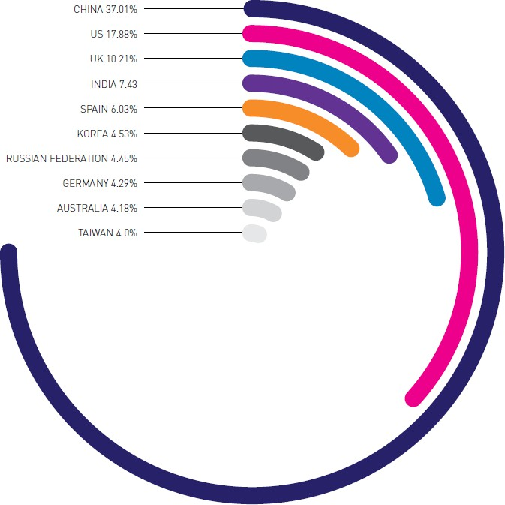
Top 10 Source Countries for DDoS Attacks
DDoS (Distributed Denial of Service) attacks overwhelm a system with traffic—like a traffic jam that blocks real users from getting through.

Slide 33
Top 10 Source Countries for DDoS Attacks
In Q2 2015, one DDoS attack reached 214 million packets per second—enough to crash core internet infrastructure like Tier 1 routers (used by ISPs).

Slide 34
Top 10 Source Countries for DDoS Attacks
Top Source Countries for DDoS Attacks:
China: 37.01%
USA: 17.88%
UK: 10.21%
Other countries include India, Spain, Korea, Russia, Germany, Australia, and Taiwan.

Slide 35
Top 10 Source Countries for DDoS Attacks
Real-world analogy: Think of each country as a faucet. China and the US have the biggest taps pouring fake traffic onto servers—flooding them until they break.

Slide 36
Top 10 Source Countries for DDoS Attacks
Student Tip: Always use firewalls, intrusion detection, and rate-limiting to help protect systems. Learn how to configure reverse proxies and load balancers for defense.

Slide 37

Cyber Threats in the Information Age
Key Point:
Over 500,000 cyberattack attempts happen every minute around the world.
Real-world analogy: Imagine someone trying to break into your house every 7 milliseconds — and that’s just your house. Now multiply that across the internet!

Slide 38
Cyber Threats in the Information Age
What it means for students:
The internet is under constant attack — no system is too small to be ignored.
These threats target devices, data, and networks—even yours.
Awareness and basic cybersecurity hygiene (updates, strong passwords, 2FA) are your first line of defense.

Slide 39
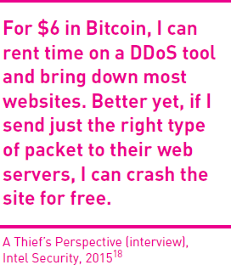
IoT: Powering the Future — and Its Risks
Key Insights:
The IoT industry was expected to hit $19 trillion globally by 2020.
Even in Australia, the smart home device market was predicted to be worth $200 million.

Slide 40
IoT: Powering the Future — and Its Risks
Real-world analogy: Think of IoT as turning every appliance in your house into a tiny computer—your fridge, lights, and even your toaster are now online. But if they’re connected, they can also be hacked.

Slide 41
IoT: Powering the Future — and Its Risks
Risk Highlight from a Hacker’s View:
“For just $6 in Bitcoin, I can rent a tool to shut down websites… or send the right packet and crash it for free.”

Slide 42
IoT: Powering the Future — and Its Risks
Student Tip: IoT is powerful—but every device is a potential backdoor. Secure them with firmware updates, network segmentation, and strong authentication.

Slide 43
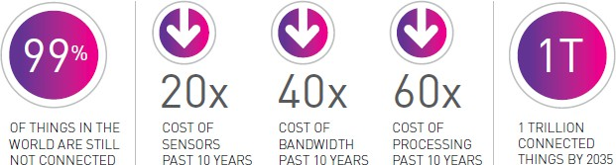
IoT Growth = Opportunity + Risk
Key Stats:
99% of things in the world are still not connected.
Costs have dropped significantly in 10 years: → Sensors ↓ 20×, Bandwidth ↓ 40×, Processing ↓ 60×
By 2035, we could have 1 trillion connected devices.
As barriers to entry drop we will see an uptake of IoT, creating a future where
attack vectors are everywhere.
Source: IoT Alliance Australia

Slide 44
IoT Growth = Opportunity + Risk
Real-world analogy: Connecting devices is like putting a microphone, camera, or brain into everything you own—from shoes to fridges. Great for automation, but also opens new doors to cyberattacks.
As barriers to entry drop we will see an uptake of IoT, creating a future where
attack vectors are everywhere.
Source: IoT Alliance Australia

Slide 45
IoT Growth = Opportunity + Risk
Security Impact:
As costs drop, more devices go online—but more devices mean more attack points.
Student Tip: The future is smart, but smart ≠ safe by default. Build with security-first principles.
As barriers to entry drop we will see an uptake of IoT, creating a future where
attack vectors are everywhere.
Source: IoT Alliance Australia

Slide 46
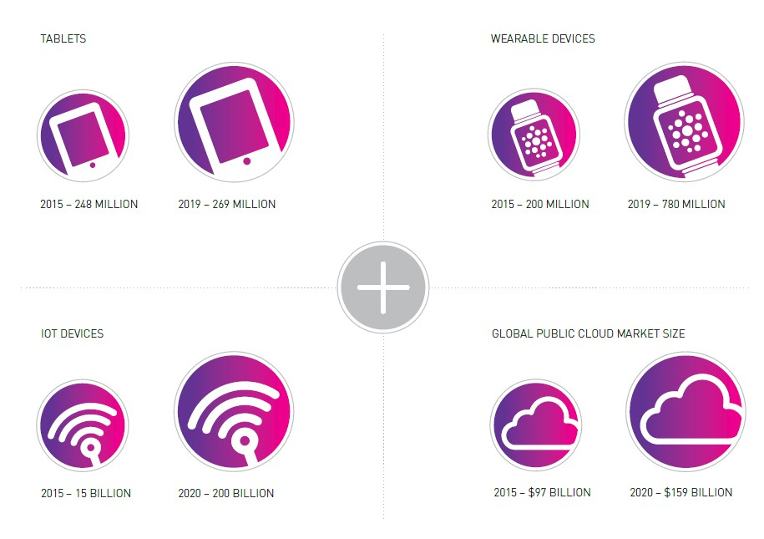
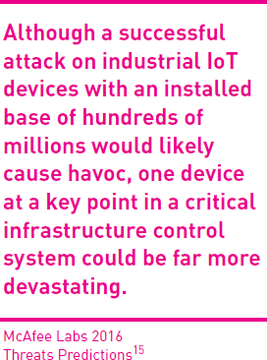
More Devices, More Threats
Key Insight:
The number of connected devices is exploding:
IoT devices: From 15B in 2015 to 200B by 2020
Wearables: From 200M to 780M
Cloud usage: Up from $97B to $159B

Slide 47
More Devices, More Threats
Real-world analogy: It’s like adding hundreds of new doors and windows to your house—without locks. More access points = more chances for a break-in.

Slide 48
More Devices, More Threats
Why It Matters:
A single compromised IoT device—especially in critical infrastructure (like a power grid or hospital system)—can cause major disruptions.
Student Tip: Don’t just count devices—secure them. Even one unprotected node in a network is a hacker’s gateway in.

Slide 49
Autonomous Systems
Driverless Cars & Transport
What happened?
In 2015, over 1.4 million Jeep Cherokees were recalled after hackers remotely took control through the car’s entertainment system.
Why it matters:
If a car can be hacked like a laptop, it’s not just data at risk—lives are.

Slide 50
Autonomous Systems
Analogy: Imagine someone changing your GPS route or slamming your brakes—while you’re not even driving!

Slide 51
How to Secure Autonomous Vehicles
1. Create a Strong Password
Don’t stick with “123456”! Just like locking your front door, always change the factory-set password.
Analogy: Leaving a default password is like putting your house key under the doormat—hackers know where to look.
https://innovationatwork.ieee.org/six-ways-to-protect-against-autonomous-vehicle-cyber-attacks/

Slide 52
How to Secure Autonomous Vehicles
2. Use Multiple Networks
Relying on just one network is risky. Cities should use backup systems to avoid full failure.
Analogy: Like having only one road in or out of town—if it’s blocked, you’re stuck.

Slide 53
How to Secure Autonomous Vehicles
3. Keep Software Updated
Updates fix bugs and block new threats. Never ignore that “update available” alert.
Analogy: Like getting vaccine boosters for new virus variants.

Slide 54
How to Secure Autonomous Vehicles
4. Prioritize Security in Apps
Only install trusted apps and systems. Make sure apps are secure before using them in your car.
Analogy: Would you download a random app to control your home locks?

Slide 55
How to Secure Autonomous Vehicles
5. Turn Off GPS When Not Needed
GPS spoofing can mislead your car’s navigation. Switch it off when you're not using it.
Analogy: It’s like someone giving you fake directions to trap you.

Slide 56
How to Secure Autonomous Vehicles
6. Know Your Vehicle
Learn how your autonomous car works. Know what it can and can’t do.
Analogy: You wouldn't fly a drone without reading the manual—same goes for smart cars!

Slide 57
Wearables – Useful but Risky
What are they?
Wearables like Apple Watch, Samsung Gear, Fitbit, and Jawbone are gaining popularity for tracking health, fitness, and daily routines.

Slide 58
Wearables – Useful but Risky
What’s the risk?
These devices collect personal data: GPS location, heart rate, blood pressure, etc.
If hacked, this data can reveal your habits, movements, and even when you're not home.

Slide 59
Wearables – Useful but Risky
Real-world analogy: Wearing a smartwatch is like walking around with a digital diary on your wrist. If someone gets access, they can read your schedule, location, and health stats.

Slide 60
Wearables – Useful but Risky
Cybersecurity Concern:
Hackers can use this data for spear-phishing or identity theft.
Your wearable can be the weakest link in your digital life.

Slide 61
Wearables – Useful but Risky
Student Tip: Use strong passwords, turn off location sharing when unnecessary, and always update firmware. Don't let convenience cost you your privacy.

Slide 62
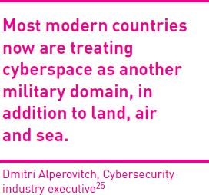
Cyberwarfare – The New Battlefield
What is it?
Today, governments, hackers, and even corporations engage in:
Cybespionage (stealing secrets)
Cyberterrorism (disrupting critical services)
Cyberwarfare (attacking nations digitally)

Slide 63
Cyberwarfare – The New Battlefield
Virtual war, real damage
Attacks happen in cyberspace, but the effects hit the real world—from power grids to banking systems.
Analogy: It’s like launching a missile through the internet instead of the sky.

Slide 64
Cyberwarfare – The New Battlefield
Key Insight:
“Cyberspace is now treated like land, sea, and air—a full military domain.” — Dmitri Alperovitch

Slide 65
Cyberwarfare – The New Battlefield
Student Tip: Stay alert—cyber defense is not just IT’s job anymore. It’s national defense.

Slide 66
Cyber Attacks on Infrastructure – Concept 1: Energetic Bear
What happened?
Energetic Bear (aka Havex) is a nation-state sponsored cyber tool, discovered in 2012.
Targeted energy, construction, and healthcare systems using a Trojan virus.
Mapped in 2014 by Kaspersky—nearly 2,800 victims globally.

Slide 67
Cyber Attacks on Infrastructure – Concept 1: Energetic Bear
Analogy: Think of Energetic Bear like a spy secretly entering company buildings through fake access cards and silently copying plans from secure drawers.
Key Learning: Cyberespionage doesn’t just target governments—it can hit infrastructure, affecting millions.

Slide 68
Cyber Attacks on Infrastructure – Concept 1: Energetic Bear
Discussion Question:
Q: Why are energy and manufacturing systems prime targets for cyberwarfare?
A: Because they are essential services. Disrupting them can cause national panic, economic losses, or physical harm, even without traditional weapons.

Slide 69
Cyber Attacks on Infrastructure – Concept 2: Stuxnet, Steelworks & Power Grid
Case Examples:
Stuxnet (2008) – A US-Israel cyberweapon disabled Iran’s nuclear program by sabotaging its centrifuges.
German Steelworks (2014) – Hackers damaged a furnace by stopping it from shutting down.
Ukraine Power Grid (2015) – 230,000 people lost power due to a suspected Russian cyberattack.

Slide 70
Cyber Attacks on Infrastructure – Concept 2: Stuxnet, Steelworks & Power Grid
Analogy: Imagine using a USB stick to silently break a factory machine or flip off a whole city’s power from your laptop—it’s war through Wi-Fi, not weapons.
Key Learning: Digital attacks can cause real-world consequences—not just data loss, but physical destruction and public chaos.

Slide 71
Cyber Attacks on Infrastructure – Concept 2: Stuxnet, Steelworks & Power Grid
Discussion Question:
Q: What lessons can we learn from cyberattacks on national infrastructure?
A: Countries must treat cybersecurity like national defense, with regular audits, updates, backup systems, and training to prevent devastating real-world outcomes.

Slide 72
When Software Fails, Lives Are Lost
Patriot Missile (1991) A software glitch caused a Patriot missile to miss its target during the Gulf War—28 soldiers died, 100 injured.
Toyota ETCS (2009) Faulty electronic throttle control led to unintended acceleration. 89 deaths, 8 million cars recalled globally.
Tesla Autopilot (2016) Autopilot failed to recognize a white trailer under bright sky. A man died in a fatal crash.

Slide 73
When Software Fails, Lives Are Lost
Key Takeaway: Software isn't just about convenience—when it controls missiles, cars, or brakes, lives are on the line.
Student Tip: Always test, verify, and validate—every bug in safety-critical systems can be deadly.

Slide 74
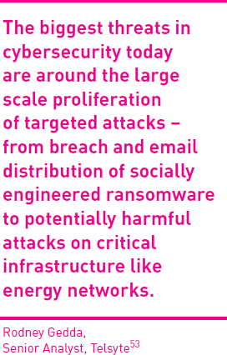
Data Manipulation – The Silent Cyber Threat
What is it?
Not all cyberattacks aim to steal or destroy data. Some attackers silently alter it—changing what people see, trust, or decide.

Slide 75
Data Manipulation – The Silent Cyber Threat
Why it’s dangerous:
Manipulated data may go unnoticed for weeks or months.
Used in espionage, cloud breaches, or virtual systems.
Targets infrastructure, governments, and critical decisions.

Slide 76
Data Manipulation – The Silent Cyber Threat
Analogy: Imagine someone changing the medicine label at a pharmacy. The pill looks safe—but the dose is wrong. That’s data manipulation.
Quote Insight:
“The biggest threats today involve silent, targeted attacks on critical infrastructure...” — Rodney Gedda, Senior Analyst, Telsyte

Slide 77
Data Manipulation – The Silent Cyber Threat
Student Tip: Focus not just on protection, but on detection. Integrity checks, audit trails, and zero-trust models help spot silent tampering.

Slide 78
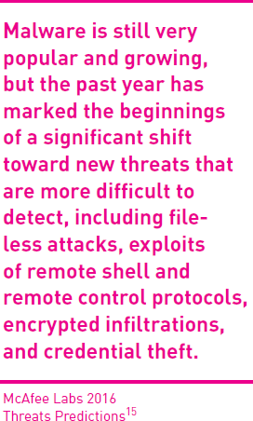
Industry and the Individual – Cybercrime Targets Everyone
What’s the threat?
Cybercrime doesn’t just hit big companies—it also targets everyday people with:
Ransomware (pay or lose your files)
Multi-vector attacks (combined phishing, malware, and network breaches)
Identity theft (using your personal info to impersonate or steal)

Slide 79
Industry and the Individual – Cybercrime Targets Everyone
Modern Malware Warning:
Today’s threats go beyond viruses—file-less attacks, remote access exploits, and encrypted breaches are rising and harder to detect. (McAfee Labs 2016)

Slide 80
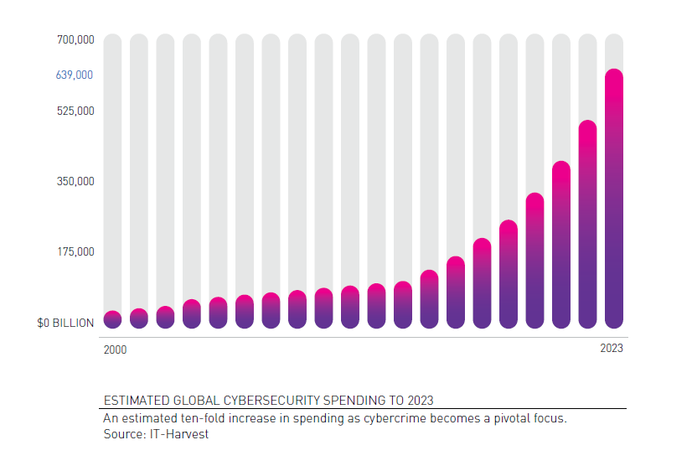
Opportunities
Global cybersecurity spending has surged nearly tenfold from 2000 to 2023, reflecting the growing urgency to combat rising cybercrime threats.

Slide 81
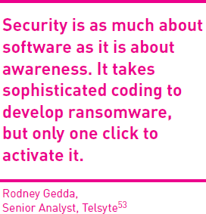
Opportunities
While cybersecurity threats grow, they also create opportunities—driving job growth, innovation, and wealth in the data-driven economy.

Slide 82
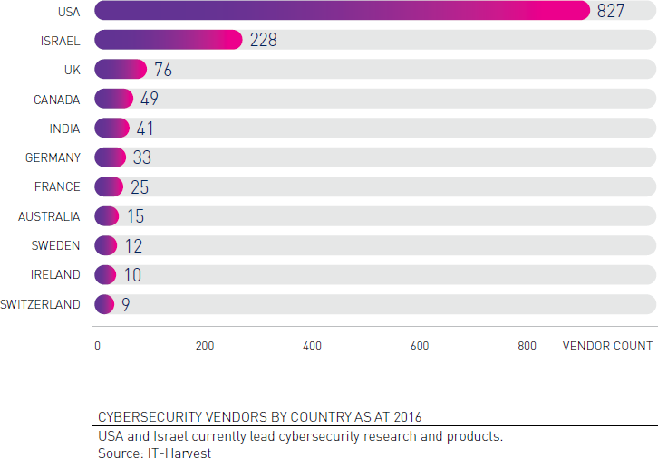
Challenges
Despite rapid growth in cybersecurity, key challenges remain—ranging from leadership and legal gaps to education, privacy, and collaboration. The USA and Israel currently lead in vendor presence, highlighting global disparities in cybersecurity capabilities.

Slide 83
Five Pillars of Cyber Security Readiness
The five pillars of cybersecurity readiness—education, planning, detection, collaboration, and ethics—form a proactive framework to prevent, respond to, and recover from cyber threats. Together, they build a culture of awareness, resilience, and trust in digital systems.

Slide 84
Summary
We have studied:
Business and social impacts of cyber attacks
Threats on IoT, ASs, Wearable devices
Cyber security challenges and opportunities

Slide 85
Next Week
Revision week

Slide 86

Questions?

